Slide 2
Module 1: Deaf Interpreters–Past, Present & Future
Unit Titles & Sequence
Historical Evolution of Deaf Interpreting
Foundational, Language, Cultural & Communication Competencies
Interpreter Service Models & Methods of Interpreting
Language, Culture, Oppression & the Deaf-World Community
Deaf Interpreter or Deaf Advocate?

Slide 3
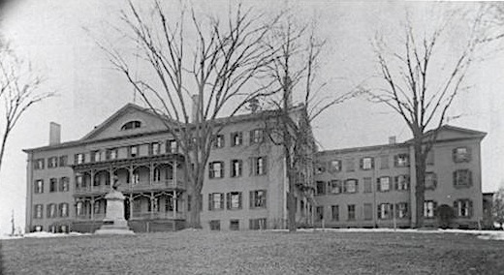
Unit 1: Historical Evolution of Deaf Interpreting
Key Questions
What knowledge and skills are required?
Why do we need a specialized curriculum in addition to generic curricula offered in ITPs?
In what situations are Deaf interpreters needed and beneficial?
How can we improve others’ perspectives of Deaf interpreters?

Slide 4
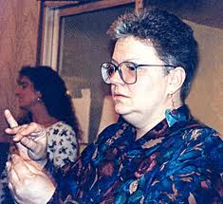
Unit 1: Historical Evolution of Deaf Interpreting
Origins of Deaf Interpreting
When did Deaf people begin to function as interpreters?
What were early Deaf interpreter roles & functions?
Research: Historical milestones

Slide 5
Unit 1: Historical Evolution of Deaf Interpreting
Deaf Interpreters: A Brief History
In colonial New England, Matthew Pratt, a Deaf person, interpreted for Sarah Pratt, his wife, during her 1683 Puritan conversion by translating her signs to written text for Puritan elders and translating the elders’ written text to signs for Sarah (Carty, Macready & Sayers, 2009)
Forestal (2011): Traditionally, Deaf people have undertaken a variety of translation and interpreting roles within the Deaf community (Bauman, 2008; Stone, 2007); only recently they have been recognized as Deaf Interpreters within the interpreting profession, as they are “brought in” to work with hearing interpreters to provide optimal information access to Deaf individuals (Langholtz, 2004)

Slide 6
Unit 1: Historical Evolution of Deaf Interpreting
Deaf Interpreters: A Brief History
Deaf Interpreters now practice in myriad settings, such as courts, hospitals, work-related sites, training programs, conferences, theatres, and classrooms across the country, primarily in major cities. They work as translators from spoken or written English into ASL, international sign language, or in a gestural form. They are now everywhere in the field of interpreting with Deaf people and where ASL-English interpreting occurs (Forestal, 2005)
Deaf interpreting has been around for centuries. Deaf people have been interpreting for each other and others since the first oldest known mention of sign language in 427-347 BC (Per Eriksson, The History of Deaf People)

Slide 7
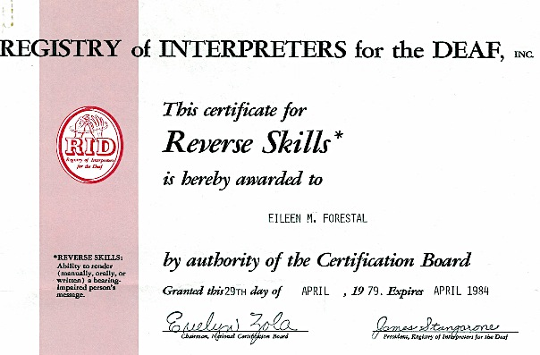
Unit 1: Historical Evolution of Deaf Interpreting
RID Reverse Skills Certificate
During what years was the RSC offered?
Describe typical RSC roles & work settings
How did RSC holders benefit consumers?
What led to RSC suspension?
What is the Deaf Caucus?
What is relay interpreting called today?

Slide 8
Unit 1: Historical Evolution of Deaf Interpreting
Interpreter Certification: Brief History
RID has since 1964 offered national testing & certification for sign language interpreters. From 1972 to 1988, RID offered the Reverse Skills Certificate (RSC); since then they have offered Certified Deaf Interpreter (CDI) testing and certification.
During the late 1980s to the mid-2000s, the NAD offered national testing and certification for sign language interpreters. In 1993, RID and NAD formed a task force; they later agreed to develop a new joint test and certification system for interpreters.
In 2005, the NAD-RID National Interpreter Certification (NIC) test was released, followed by the NAD-RID Code of Professional Conduct (CPC). Both organizations continue to collaborate.

Slide 9
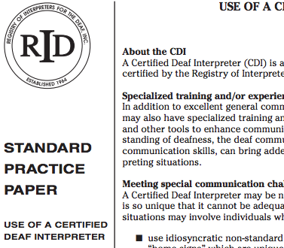
Unit 1: Historical Evolution of Deaf Interpreting
RID Standard Practice Paper: Use of a Certified Deaf Interpreter
What functions of DIs go beyond the SPP?
How does the SPP advocate for use of Deaf interpreters?
In what ways should the SPP be updated?

Slide 10
Unit 1: Historical Evolution of Deaf Interpreting
RID Certified Deaf Interpreters
What are the benefits of DI/HI teams?
In what ways do CDIs benefit Deaf & DeafBlind consumers?
What specialized training requirements do prospective & working Deaf interpreters require?
In what ways are the roles & functions of Deaf interpreters evolving?
How can we further the professionalization of Deaf interpreters?

Slide 11
Unit 2: Foundational, Language, Cultural & Communication Competencies
Key Questions
How can Deaf interpreters use formative experiences for self-assessment?
How do foundational competencies prepare individuals to work as Deaf interpreters?
Foundational competences support what Deaf interpreter skill sets?

Slide 12
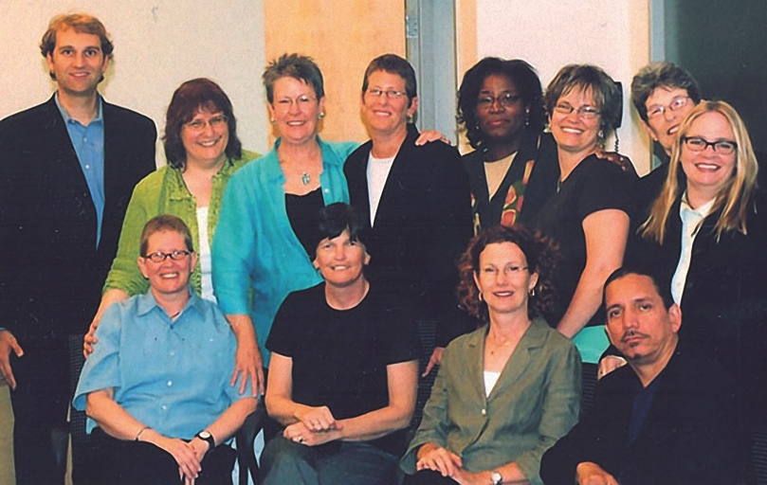
Unit 2: Foundational, Language, Cultural & Communication Competencies
Deaf Interpreters
What are four key skill areas?
Why is it important to analyze one’s own biases?
What linguistic skills are required?
Why is it important to be comfortable in a variety of bicultural and bilingual settings?
What areas of interpreter practice are of primary importance?

Slide 13
Unit 2: Foundational, Language, Cultural & Communication Competencies
Foundational Competencies
What is your exposure to ASL & other signed languages?
What are your past experiences dealing with various communication modes and forms used by Deaf people?
How have these experiences influenced you as a Deaf interpreter?
Why is analysis of personal challenges (e.g., comprehending situations, interpreters, communication styles) of critical importance?
How have or will personal experiences of discrimination & oppression impact you as a Deaf interpreter?

Slide 14
Unit 2: Foundational, Language, Cultural & Communication Competencies
Language & Cultural Competencies
Evaluate your ASL skills; in what areas are you native or native-like?
Are you fluent in additional signed language/s?
Do you have spontaneous use of pragmatic & sociolinguistic features of ASL?
Are you adept and flexible in working across a range of registers, genres, and variations of ASL?
How will you develop competencies in the above areas?

Slide 15
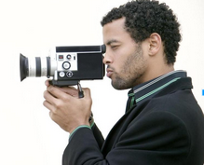
Unit 2: Foundational, Language, Cultural & Communication Competencies
Language & Communication Competencies
Review rubrics for ASL, visual gestural communication, and home signs
Work in pairs, share experiences of growing up, then use rubrics to assess one’s own and partner's language skills
Engage in dialogue on skills assessment findings

Slide 16
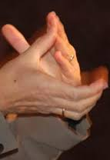
Unit 3: Interpreter Service Models & Methods of Interpreting
Evolution of Interpreter Service Models & Application to Deaf interpreters
Helper
Conduit/machine
Language facilitator
Bilingual-bicultural mediator
Ally

Slide 17
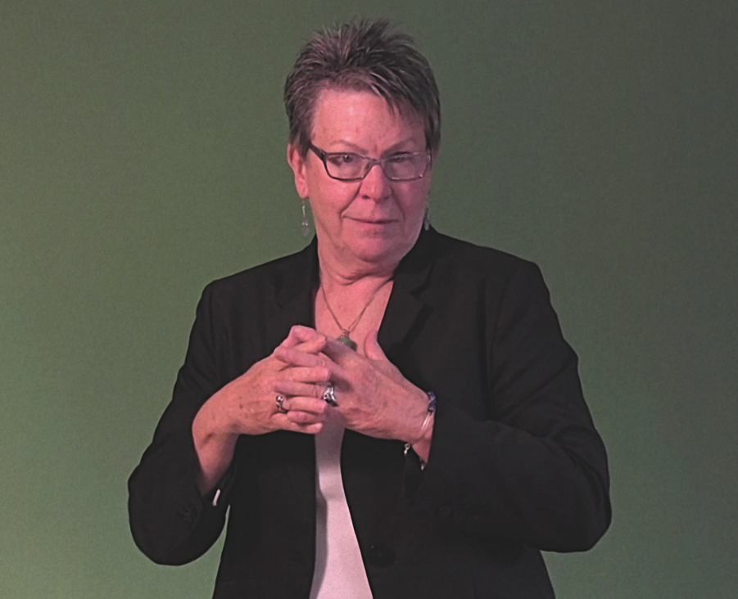
Unit 3: Interpreter Service Models & Methods of Interpreting
Which Methods Used Most by Deaf Interpreters?
Simultaneous
Consecutive
Application of Processes to Deaf Interpreters?
Interpretation
Transliteration
Sight Translation
Mirroring

Slide 18
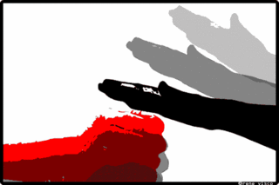
Unit 4: Language, Culture, Oppression & the Deaf-World Community
Personal Experiences: Impact Deaf Interpreter Effectiveness & Practice
Discrimination
Oppression
Lack of access to communication
How can Deaf interpreters mediate the potential pitfalls of identifying with consumers’ experiences?

Slide 19
Unit 5: Deaf Interpreter or Deaf Advocate?
Self-Analysis
What does advocacy mean?
Does the work of Deaf interpreters include advocacy?
Do you want to be a Deaf interpreter or a Deaf advocate?
How might your role/s affect your work as a Deaf interpreter?

