Slide 2
Ethnic & Cultural Diversity within the Deaf Community
Unit Titles & Sequence
  Ethnic & Cultural Diversity
  Examining Cultural Differences
  Examining Bias & Stereotyping
  Immigrants & Refugees
  Knowledge & Skills Needed as a Deaf Interpreter

Slide 3

Unit 1: Ethnic & Cultural Diversity
Key Questions
  How do organizations established to support Deaf people of color address the needs of the people they serve? In what ways can they more fully support the people they serve?
  What can these organizations do to support the work of Deaf interpreters?
  In what ways can Deaf interpreters, who are not themselves people of color, benefit from joining organizations such as NBDA and NCHDHH and learning more about these cultures?
  Is it possible for individuals to not have any stereotypes and biases?

Slide 4
Unit 1: Ethnic & Cultural Diversity
Group Dialogue
  What ethnic cultures exist within the Deaf community?
  What organizations exist to support Deaf people of color? How are these organizations addressing issues unique to immigrants and refugees?
  To what ethnic group(s) do you belong?
  What are your experiences as a Deaf person of color, if applicable?
  Have you worked with Deaf people whose ethnicity is different from yours? If yes, what insights can you share that would be helpful to Deaf interpreters who may work with Deaf people of color?

Slide 5

Unit 1: Ethnic & Cultural Diversity
Organizational Analysis
  Mano a Mano
  National Alliance of Black Interpreters
  National Asian Deaf Congress
  National Association of the Deaf
  National Black Deaf Advocates
  National Council of Hispano Deaf and Hard of Hearing
  Registry of Interpreters for the Deaf
  Sacred Circle

Slide 6

Unit 1: Ethnic & Cultural Diversity
Organizational Analysis, cont’d
  How do these organizations support their members?
  What is missing?
  Would you join one of these organizations?
  Why or why not?

Slide 7
Unit 2: Examining Cultural Differences
Key Questions
  Why is it important for Deaf interpreters to understand their culture before working with people of different cultures?
  What challenges may be present for Deaf interpreters when working outside of their culture?
  In what ways can Deaf interpreters demonstrate respect for the beliefs and mores of consumers of ethnicities or cultures that are different from theirs?
  Why is it important for Deaf interpreters to understand minority group dynamics and the impact of oppression on the Deaf community in general? Deaf people of color?

Slide 8

Unit 2: Examining Cultural Differences
Analysis of Cultural Elements
  Linguistic behaviors
  Nonverbal behaviors
  Temporal orientation
  Thinking & cognitive processes
  Religious/spiritual affiliation
  Observances
  Dominant ethnic identity
  Decision making /action taking attitude

Slide 9
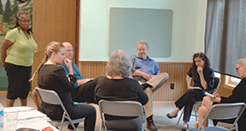
Unit 2: Examining Cultural Differences
Linguistic Behaviors
  Accent
  Dialect
  Sign choice

Slide 10
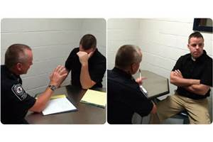
Unit 2: Examining Cultural Differences
Nonverbal Behaviors
  Facial expression
  Gestures
  Use of space
  Eye contact

Slide 11
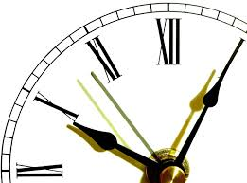
Unit 2: Examining Cultural Differences
Temporal Orientation
  Deaf vs. Hearing time
  Black vs. White time
  Others??
  USA: Time runs
  Latin America: Time walks

Slide 12

Unit 2: Examining Cultural Differences
Thinking/Cognitive Processes
  Concrete vs. abstract
  Black and white
  Linear vs. conceptual/pictorial
  Socialized vs. isolated/independent

Slide 13
Unit 2: Examining Cultural Differences
Thinking/Cognitive Processes – Activity
First thoughts
  No filtering
  No screening
  No analysis

Slide 14

Unit 2: Examining Cultural Differences
Religious/Spiritual Affiliation
  Beliefs
  Rituals
  Traditions

Slide 15
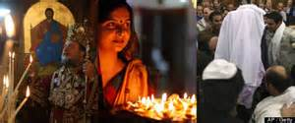
Unit 2: Examining Cultural Differences
Observances
  Celebrations
  Holidays
  Ceremonies

Slide 16
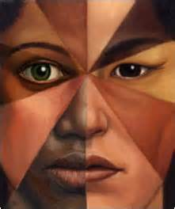
Unit 2: Examining Cultural Differences
Dominant Ethnic Identity
  Self-identification
  National origin/affiliation
  Ethnic density
    Biracial
    Multiracial

Slide 17

Unit 2: Examining Cultural Differences
Decision Making/Action-Taking Attitude
  Individualistic
  (Western cultures)
    Internal vs. external factors
  Collectivist/Consensual (Non-Western)
    Interdependence vs. independence

Slide 18
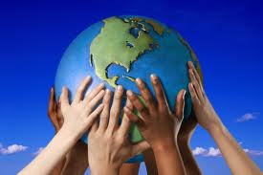
Unit 2: Examining Cultural Differences
Cultural Elements: Group Dialogue
  How does what you’ve learned relate to your culture?
  How does this relate to other cultures?
  Why is this important for interpreters?
  How does this help you as a Deaf interpreter?

Slide 19

Unit 2: Examining Cultural Differences
Case Study Analysis
  Selection of one of the five case studies
  Approach to the interpreting assignment
  Resources needed
  Application of Demand-Control Schema
    Challenges/behaviors that may impact the interpreting situation
    Communication barrier/s or interpersonal conflicts
    Mitigation of barriers/managing of conflicts

Slide 20
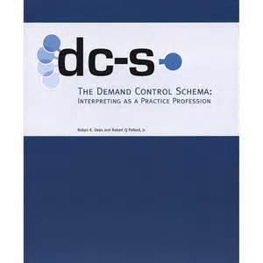
Unit 2: Examining Cultural Differences
Demand-Control Schema
  Demands
    Environmental
    Interpersonal
    Para-linguistic
    Intrapersonal
  Controls
    Pre-assignment
    Assignment
    Post-assignment

Slide 21
Unit 2: Examining Cultural Differences
Demand-Control Schema, cont’d
  Challenges and how different behaviors may affect an interpreted interaction
  Barriers to communication or an interpersonal conflict
  Mitigating barriers or managing conflicts

Slide 22
Unit 2: Examining Cultural Differences
Group Dialogue: From the Deaf Multicultural Perspective
  What demands did the interpreter face in each of the assignments?
  What controls could they have used?
  What did you learn from this activity?
  How will this activity help you in deciding whether or not to accept an assignment?
  Have you or someone you know had a similar experience? If yes, what lessons can you use to interpret more effectively?

Slide 23

Unit 3: Examining Bias & Stereotyping
Key Questions
  What gives rise to biases and stereotypes?
  Why is it important to examine personal bias?
  In what ways can bias and stereotypes influence interpreting processes?
  What strategies work effectively when bias and stereotyping (either yours or others’) influences or interferes with interpreting?

Slide 24
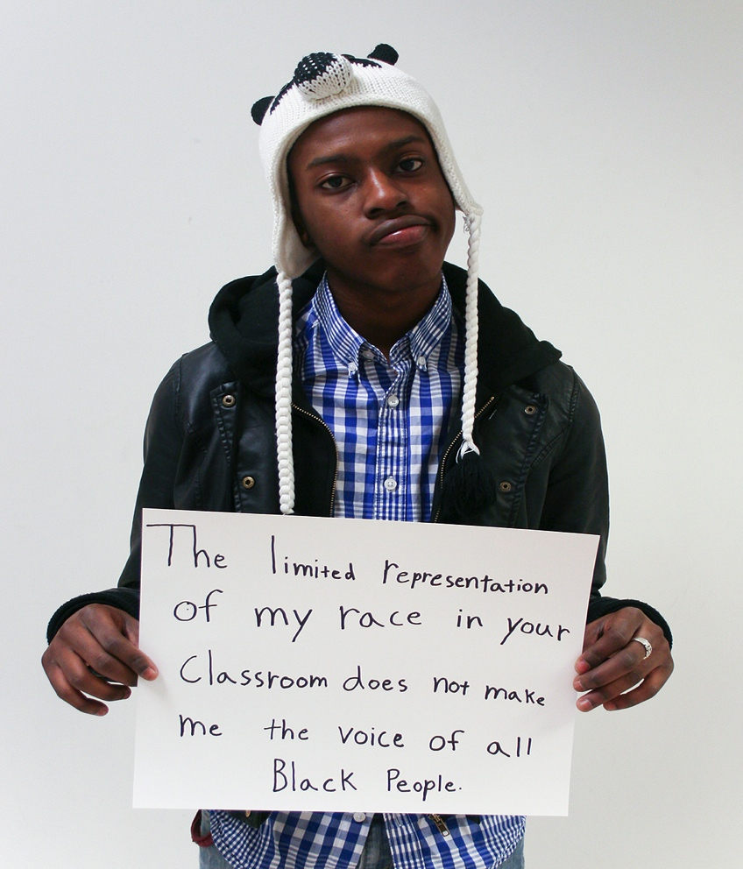
Unit 3: Examining Bias & Stereotyping
Concept Review
  Bias – One sided, prejudice for or against
  Stereotyping – Oversimplified or standard image; negative
  Does bias tend to be negative?

Slide 25
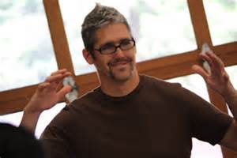
Unit 3: Examining Bias & Stereotyping
Group Dialogue: Redefining D-E-A-F
  Stuart Hall (19:11-24:49)
  Contesting Stereotypes (31:42-33:14)
Terminology
  Limited information-stuck with standards
  Powerlessness-to change

Slide 26
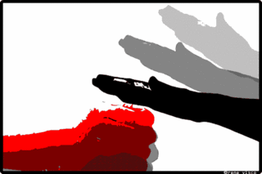
Unit 3: Examining Bias & Stereotyping
Group Dialogue
  How does oppression feel?
  How does oppression affect others?

Slide 27
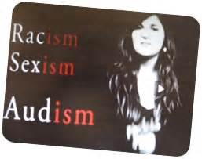
Unit 3: Examining Bias & Stereotyping
Characteristics of Oppression
  Being put down
  Feeling inferior
  Denied privilege, opportunity or service

Slide 28
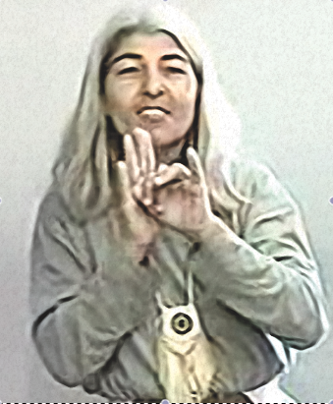
Unit 3: Examining Bias & Stereotyping
Group Dialogue: Muskogee Indian Donnette Reins
  Hair cut & style
  Black garb
  Totem pole

Slide 29
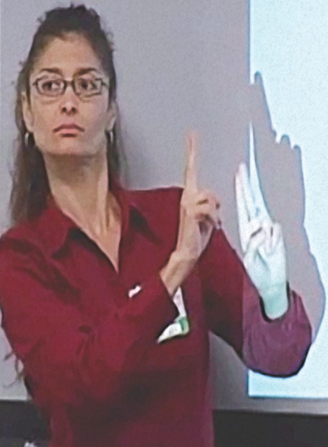
Unit 3: Examining Bias & Stereotyping
Group Dialogue: Are You a Victim of White Privilege, Hearing Privilege or Both?
  What is white privilege?
  What is hearing privilege?

Slide 30

Unit 3: Examining Bias & Stereotyping
Group Dialogue
  Characteristics of oppression
  Meaning and impact of privilege
  Power relationships and impact on interpreted interactions
  Impact of consumer position within power dynamic on interpreting decisions or dynamics

Slide 31

Unit 3: Examining Bias & Stereotyping
Privilege Walk Debriefing
  What happened?
  How did this exercise make you feel?
  What were your thoughts as you did this exercise?
  What have you learned from this experience?
  What can you do with this information in the future?

Slide 32
Unit 3: Examining Bias & Stereotyping
Group Dialogue
  Ethnic cultures/linguistic groups you are most/least comfortable working with
  Personal experience with bias/stereotyping
  Overcoming bias/stereotyping due to race or hearing status
  Taking action if you witness biases/stereotyping
  Reducing your biases/stereotyping

Slide 33
Unit 4: Immigrants & Refugees
Key Questions
  How have immigrants contributed to diversity within the Deaf community?
  How have refugees contributed to diversity within the Deaf community?
  What do refugees and immigrants have in common?
  How do refugees and immigrants differ?
  What organizations, if any, exist to support Deaf and DeafBlind immigrants and refugees?

Slide 34
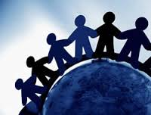
Unit 4: Immigrants & Refugees
Group Dialogue
  How are refugees viewed in the USA?
  With the previous questions in mind, how do people in the USA view Deaf people who immigrate or are refugees?
  Describe personal perceptions, as Deaf interpreters, toward immigrants and refugees?

Slide 35
Unit 4: Immigrants & Refugees
Group Dialogue
  How are immigrants and refugees alike?
  How are they different?
  Relate your experiences working with either or both groups

Slide 36
Unit 4: Immigrants & Refugees
Group Dialogue: Trainer-Selected Videos
  What are your thoughts and reactions?
  What unique issues do immigrants and refugees face that are different from those in the mainstream Deaf or DeafBlind communities?
  What organizations or resources might be able to provide support?
  Did you become more aware of your own biases or stereotypes?
  How would you apply what you have learned as a Deaf interpreter?

Slide 37
Unit 5: Knowledge & Skills Needed as a Deaf Interpreter
Key Questions
  What ethnicities exist within the Deaf community?
  What experiences do you have as a Deaf interpreter with ethnically diverse Deaf people?
  How does/did this experience impact or influence your effectiveness as a Deaf interpreter?
  What knowledge and skills do you possess that enables you to work as a Deaf interpreter with ethnically diverse consumers?

Slide 38

Unit 5: Knowledge & Skills Needed as a Deaf Interpreter
Domains & Competencies
  Which apply to Deaf interpreters working with culturally diverse Deaf people?
  Which competencies support Deaf interpreter work effectiveness?
  How do these impact Deaf interpreter practice?

Slide 39
Unit 5: Knowledge & Skills Needed as a Deaf Interpreter
Group Dialogue: Muskogee Indian Donnette Reins
  What was Donnette’s dominant culture?
  Did this change? If so, how?
  What signs were used that are different than yours?
  Are these signs permitted outside of her culture? Why/why not?
  Could adopting her signs/culture-specific gestures support the interaction?
  How was this activity helpful for you as a Deaf interpreter?

Slide 40
Unit 5: Knowledge & Skills Needed as a Deaf Interpreter
Group Dialogue: Trainer-Selected Videos
  What challenges or issues (demands) must Deaf interpreters be aware of when working in a setting outside of their culture?
  What, if any, cultural and linguistic errors did the interpreters make?
  How is using a sign language interpreter who knows the consumer’s country sign language (controls) helpful?
  Describe logistical considerations (controls) for effective interpreting at cultural events

Slide 41
Unit 5: Knowledge & Skills Needed as a Deaf Interpreter
Group Dialogue: Trainer-Selected Videos, cont’d
  Are you skilled and knowledgeable in another sign language/s or culture/s?
  What would you do if you were called to interpret an event or meeting that was outside of your cultural/linguistic comfort zone? What demands would exist? What controls could be used to address the demands?
  What resources may be helpful when working with people who are ethnically diverse?

Slide 42
Unit 5: Knowledge & Skills Needed as a Deaf Interpreter
Group Dialogue: Reflections on Cultural & Religious Diversity by L.G. Peterkin
  What cultural adjustments did Lillian make when working with the client?
  What extra-linguistic knowledge (ELK) did she have that supported her work with this ethnic group?
  What adjustments can you make when working both within and outside of your ethnicity?

Slide 43
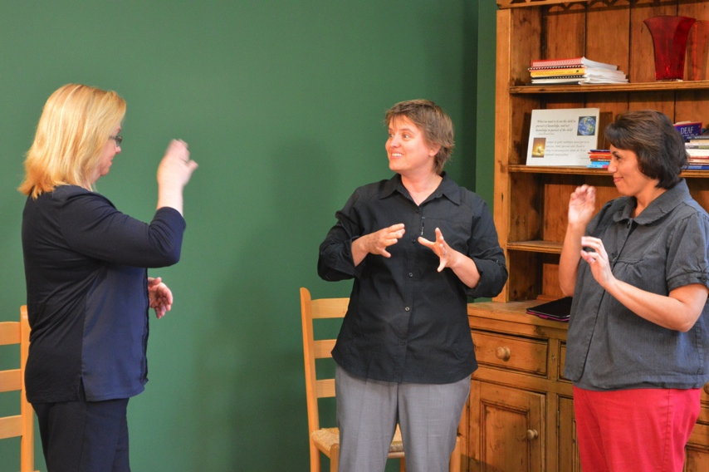
Unit 5: Knowledge & Skills Needed as a Deaf Interpreter
Group Discussion
Using the five Case Study worksheets, discuss strategies for working with various consumers
  Linguistic challenges
  Inter- and intra-personal challenges
  Interpreting strategies and rationale
  Other considerations needed

